Slide 1
PC Maintenance: Preparing for A+ Certification
Chapter 14: Configuring Devices in Windows

Slide 2
Chapter 14 Objectives
Identify resources that devices need
Learn default resource assignments (memorize for A+ exam)
Explain Plug and Play
View and change resource assignments in Windows
Update device drivers
Disable devices

Slide 3
Device Resources
Interrupt Requests (IRQs)
I/O Addresses
Memory Addresses
Direct Memory Access (DMA) Channels

Slide 4
Default Resource Assignments
IRQ | Device
0 | System Timer
1 | Keyboard Controller
2 | Cascade to IRQ 9
3 | COM2, COM4
4 | COM1, COM3
5 | LP2 or sound card
6 | Floppy drive controller
7 | LPT1
IRQ | Device
8 | Real-time clock
9 | Cascade IRQ 2 / Available
10 | Available
11 | SCSI expansion board or Available
12 | Mouse port or Available
13 | Math coprocessor
14 | Primary IDE
15 | Secondary IDE

Slide 5
Plug and Play
Requires:
  PnP compatible motherboard
  PnP compatible device being installed
  PnP compatible operating system
Purpose:
  Enables BIOS to interact with device
  Identifies device to OS
  Automatically installs the driver if it is readily available

Slide 6
Advanced Configuration and Power Interface (ACPI)
Two purposes:
  Manages PnP device resources
  Enables power conservation utilities
Requires:
  ACPI-compliant motherboard BIOS
  ACPI-aware operating system

Slide 7
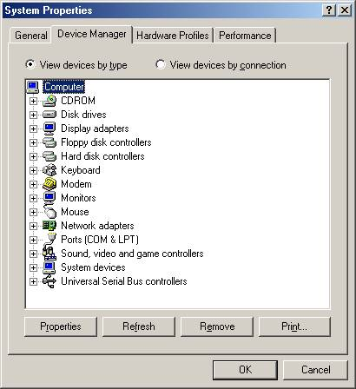
Viewing Resource Assignments in Windows
In Windows 9x: Device Manager tab in System Properties box

Slide 8
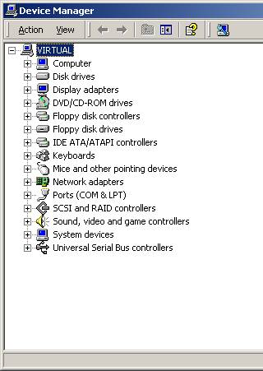
Viewing Resource Assignments in Windows
In Windows 2000/XP:
Click Device Manager button on Hardware tab of System Properties box

Slide 9
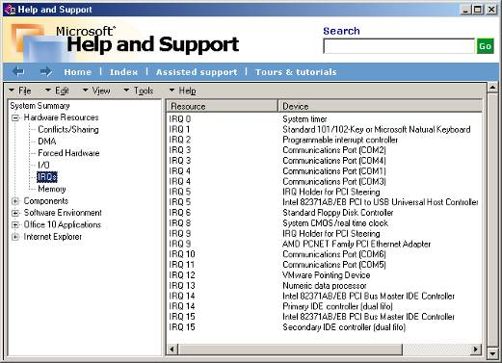
System Information
Available in Windows 98 and higher from Accessories/System Tools menu

Slide 10
Installing Plug and Play Devices
Windows detects new device
Looks for a driver
  If found, installs automatically
  If not found, prompts for a disk
Assigns resources to the device

Slide 11
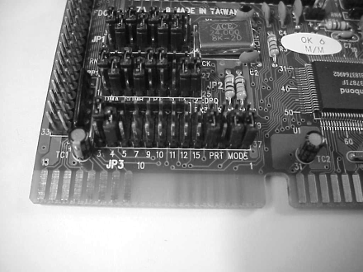
Installing Non-PnP Devices
Jumpers may be required to be set on the board
Windows will respect the device’s demand for particular resources if possible

Slide 12
Device Drivers
Software that interprets between the OS and the device
Information needed for driver installation contained in an INF file
The actual driver is a SYS or DLL file or a combination of files

Slide 13
Update a Driver
Find device in Device Manager and double-click it
On Driver tab, click Update Driver button
Follow the prompts

Slide 14
Signed Drivers
Used in Windows XP to ensure driver integrity
Warning appears if unsigned driver is attempting to install
Look online for updated, signed drivers when possible
Install an unsigned driver only as a last resort

Slide 15
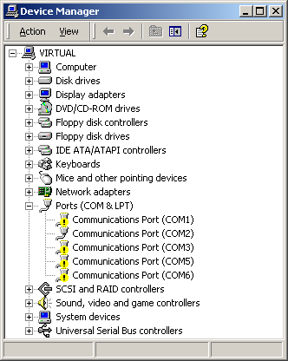
Identifying a Resource Problem
Look for exclamation point icon in Device Manager
Double-click device to find out what’s wrong with it

Slide 16
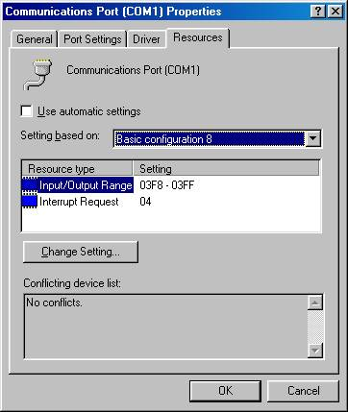
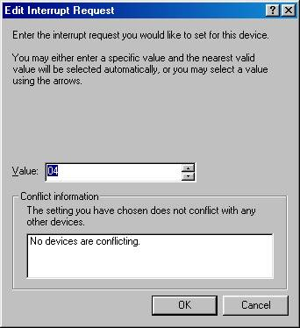
Manually Changing Resource Assignments
Try a different configuration
Change individual resource if needed

Slide 17
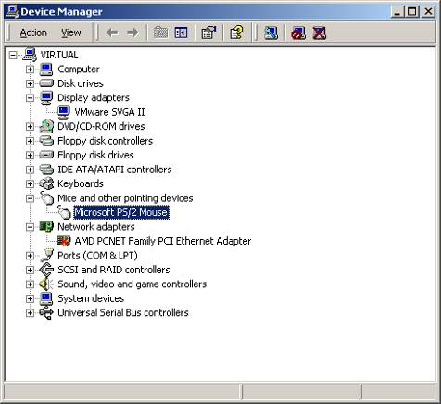
Disable a Device
Different from uninstallation
Leaves device on the list but takes away its resources
Uninstall
Disable

